Slide 1
Multimodal Empathetic AI Companion using CNN–Bidirectional LSTM–Transformer Hybrid Architecture
PROJECT TEAM: 1. MANVITHA A GOWDA (USN: 4PS22CS098) 2. RACHANA M S (USN: 4PS22CS132) 3. RAKSHITHA M (USN: 4PS22CS134) 4. RISHITHA U M (USN: 4PS22CS137)
PROJECT GUIDE: MRS. SRUJANA B J DEPARTMENT OF COMPUTER SCIENCE AND ENGINEERING P.E.S COLLEGE OF ENGINEERING, MANDYA

Slide 2
Motivation
Emotional well-being is critical in modern society.
AI assistants (Alexa, Siri, Google Assistant) lack empathy.
Humans express emotions through speech, face, and text — AI should understand all three.
The goal is to build an empathetic AI companion capable of emotional understanding and support.

Slide 3
Problem Statement
Current AI systems are task-oriented, not emotionally aware.
Existing emotion recognition systems are unimodal and less accurate.
No integrated mechanism for empathetic response or distress alert.
Need for a real-time multimodal empathetic AI that supports users emotionally and motivates them.

Slide 4
Objectives
Design a multimodal emotion recognition model.
Combine CNN (visual), BiLSTM (audio), and Transformer (text).
Fuse data using cross-modal attention + fuzzy logic.
Generate empathetic responses using LLM-based Emotion-Aware response generation (speech/text).

Slide 5
Literature Survey (Summary Table)
S. No. | Author(s) & Year | Title / Source | Technique / Model Used | Dataset / Domain | Key Findings / Accuracy | Relevance to Project
[1] | Dong Zhang & Qichuan Tian (2021) | A Novel Fuzzy Optimized CNN–RNN Method for Facial Expression Recognition (Elektronika ir Elektrotechnika) | CNN–RNN hybrid with fuzzy optimization | CK+, FER2013 | Enhanced accuracy and robustness using fuzzy logic–based CNN–RNN | Foundation for CNN–BiLSTM hybrid emotion modeling
[2] | Qinrui Hu (2024) | Sentiment Analysis and Facial Expression Recognition in Customer Service (Frontiers in Business, Econ. & Mgmt.) | CNN for FER + LSTM for sentiment fusion | Custom video/text dataset | Achieved 92.3% multimodal emotion accuracy | Demonstrates fusion of visual and textual emotion cues
[3] | Chenxi Li (2025) | AIVA: AI-based Virtual Companion for Emotion-aware Interaction (arXiv:2509.03212) | Multimodal Transformer Fusion + LLM | Text + Visual + Audio | Emotion-aware interaction using multimodal transformer | Supports empathetic AI design through multimodal fusion
[4] | Nanda M. B. et al. (2025) | Developing an Empathetic AI Companion Using Sentimental Analysis (JETIR) | DeepFace + SpeechRecognition + NLP | Real-time webcam & mic input | Real-time empathetic chatbot prototype | Closely aligns with proposed empathetic companion system
[5] | M.N.V.L. Narayana et al. (2025) | Real-Time Facial Emotion Recognition System (IJSRED) | CNN + PAD Model (Pleasure–Arousal–Dominance) | Real-time video input | 94% emotion recognition accuracy | Validates real-time FER feasibility and emotional scaling

Slide 6
Existing System
Functional assistants (Siri, Alexa) → No empathy.
Mostly rule-based systems with scripted replies.
Lack of emotional recognition or motivational response.
No distress alerts or privacy mechanisms.

Slide 7
Proposed System Overview
Multimodal Emotion Recognition (face + voice + text)
Deep learning hybrid: CNN + BiLSTM + Transformer
Cross-modal attention fusion with fuzzy weighting
Empathetic speech/text responses
Motivational module and guardian alerts

Slide 8
Tools and Technologies
Software: Python, PyTorch/TensorFlow, OpenCV, HuggingFace Transformers, Flask, Twilio API
Hardware: GPU system (GTX 1650+), webcam, microphone, 8GB+ RAM

Slide 9
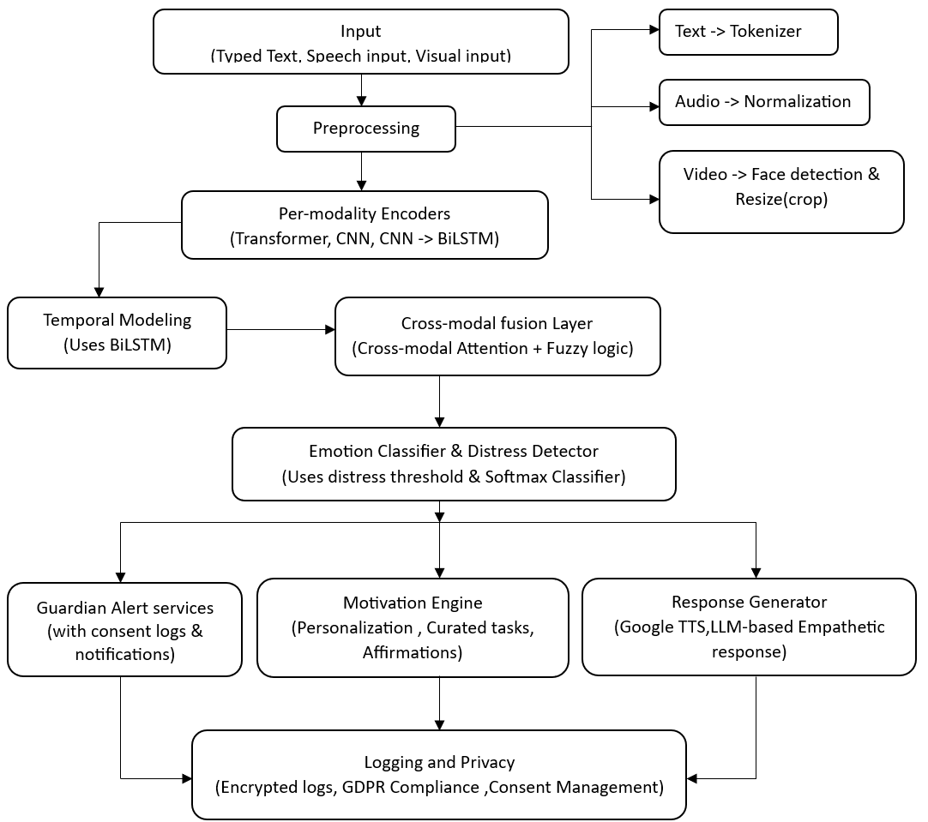
System Architecture

Slide 10
Methodology
Data Collection: FER2013 (visual), RAVDESS (audio), MELD (multimodal).
Preprocessing:
-Audio → Mel-spectrogram
-Video → Face detection (MTCNN)
-Text → Tokenization (Transformer)
Training: CNN–BiLSTM–Transformer models
Fusion: Cross-modal attention
Emotion Classification + Distress Detection
Response Generation + Alerts

Slide 11
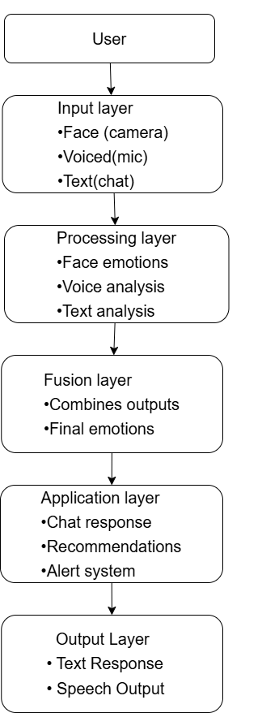
System Design Overview
The system follows a modular architecture
Divided into:
Input Layer (Face, Voice, Text)
Processing Layer (Emotion Detection)
Fusion Layer (Combine modalities)
Application Layer (Chat, Alerts, Recommendations)
Each module works independently
Designed for real-time interaction and accuracy

Slide 12
Hybrid Model And Fusion Mechanism
Hybrid Model:
CNN → Facial emotion detection
BiLSTM → Speech emotion analysis
Transformer → Text understanding
Combines:
Spatial features (face)
Temporal features (voice)
Contextual features (text)
Fusion Mechanism:
Combines outputs from all modalities
Current: Majority voting / simple fusion
Future: Attention-based fusion

Slide 13
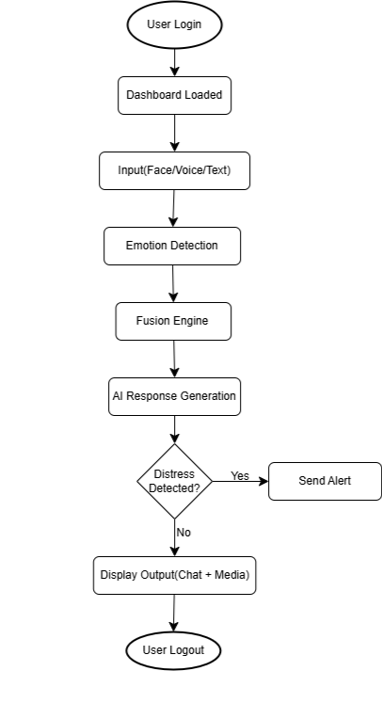
System workflow
User logs in and accesses the dashboard
User provides input (face, voice, text)
System detects emotion from each input
Fusion engine combines results to get final emotion
AI generates empathetic response
System recommends music/videos based on emotion
Distress detection triggers alert if needed
Output is displayed to the user
User continues interaction or logs out

Slide 14
Expected Outcomes
90–95% emotion recognition accuracy
Real-time empathetic chatbot interaction
Automatic guardian alert system
Personalized motivation (tasks/videos/affirmations)
Secure, privacy-compliant emotional data handling

Slide 15
Conclusion & Future Scope
Conclusion:
The proposed system bridges the gap between emotion and AI.
Delivers empathy, motivation, and safety in real time.
Future Enhancements:
Avatar-based emotional expressions.
Integration with wearables (heart rate, EEG).
Deployment as mobile/AR companion.

Slide 16
THANK YOU

